Slide 1
Smart Recruitment Assistant Project
Team members:
 | NAME | CONTRIBUTION
1 | Kerolos Nagih | Team Leader—Model Training
2 | Shnoda Faik Botros | EDA & Visualization
3 | Kyrillos Mamdouh | Feature Engineering & Preprocessing
4 | Merna Shokralla | Final Prediction System & Integration
5 | Nouran Hisham Mokhtar | Data Understanding & Dataset Analysis
6 | Basmala Mohamed Hassan | Data Cleaning & Missing Values
7 | Nourhan Soliman | Model Evaluation & Model Selection

Slide 2
1. Project Overview
Industry Background Modern organizations receive large numbers of applications, making manual screening time-consuming and difficult to scale.
Project Goal Build a Machine Learning system that predicts a candidate’s job-change intention and provides HR with an additional signal during initial screening.
Dataset HR Analytics: Job Change of Data Scientists — 19,158 records × 14 columns
Problem Definition
Recruitment Challenge
Project Objective
Decision Support
Predict whether a candidate belongs to the job-change class using available profile, career, company, and training information.
Provide HR with an additional data-driven signal for prioritization during the first screening stage.
Large candidate pools make manual screening repetitive, time-consuming, and difficult to scale consistently.
02 / 12

Slide 3
2. Dataset & Target
19,158
14
75.07%
24.93%
records
original columns
target = 0
target = 1
FEATURE GROUPS
TARGET
• Location: city, city development index • Profile: gender, education, major discipline • Career: relevant experience, experience, last new job • Organization: company size, company type • Training: training hours
0 = not looking for a job change 1 = looking for a job change
The target is imbalanced: 14,381 observations are class 0 and 4,777 are class 1. This makes Recall and F1 important evaluation measures.
03 / 12

Slide 4
3. Data Understanding & Cleaning
Initial Structure
Missing Values
Cleaning Actions
19,158 rows × 14 columns. The dataset contains 10 categorical columns, 2 numeric predictors, an ID, and the target.
Largest gaps: company_type 32.05%, company_size 30.99%, gender 23.53%, major_discipline 14.68%.
High-missing categorical fields → “Unknown”; lower-missing fields → mode; categorical strings stripped.
ADDITIONAL CHECKS
WHY IT MATTERS
• enrollee_id was removed because it is an identifier rather than a predictive attribute. • Target values were validated before modeling. • Final validation reported 0 missing values. • The notebook reports 50 duplicate rows at the final cleaning check.
Cleaning prevents missing information and non-predictive identifiers from distorting the learning process, while preserving useful categories such as company size.
04 / 12

Slide 5
4. EDA & Feature Preparation
Target Distribution
Training Hours
City Feature
About 75% of candidates are class 0 and 25% are class 1. The imbalance was considered during evaluation.
training_hours was strongly right-skewed (≈1.82), so log1p was applied; skew became approximately −0.35.
city contains 123 unique values. It was removed to avoid unnecessary high-cardinality encoding; city_development_index was retained.
TRANSFORMATIONS
MODEL-READY DATA
• experience mapped from ordered text to numeric levels • last_new_job mapped from “never” through “>4” to numeric values • training_hours transformed using log1p • city removed after feature review
• 80/20 stratified train/test split • 15,326 training rows; 3,832 test rows • One-hot encoding for categorical variables • StandardScaler for four numeric features
After encoding: 34 features in both X_train and X_test.
05 / 12

Slide 6
5. Machine Learning Approach
1
2
3
4
5
6
7
Data Understanding
→
Data Cleaning
→
EDA
→
Feature Engineering & Preprocessing
→
Model Training
→
Evaluation & Selection
→
Final Prediction
CLASSIFIERS
Logistic Regression
Random Forest
Decision tree
Baseline linear classifier used for comparison.
Ensemble of trees; achieved the strongest F1 score
Interpretable tree-based classifier for non-linear rules
Evaluation metrics: Accuracy • Precision • Recall • F1 Score Selection criterion: highest F1 Score because the target classes are imbalanced.
06 / 12

Slide 7
6. Results & Model Selection
Model | Accuracy | Precision | Recall | F1 Score
Logistic Regression | 76.93% | 57.54% | 28.38% | 38.01%
Decision tree | 70.28% | 41.25% | 45.45% | 43.25%
Random Forest | 78.31% | 57.58% | 49.32% | 53.13%
53.13%
Best F1 Score
Selected Model: Random Forest
Random Forest was selected because it achieved the best overall balance across the evaluation metrics, with the highest:
Accuracy
Precision
F1-Score
07 / 12

Slide 8
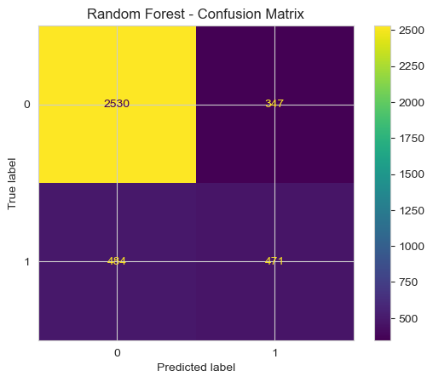
7. Best Model — Confusion Matrix
Random Forest
INTERPRETATION
• True Positive: correctly predicted class 1 • True Negative: correctly predicted class 0 • False Positive: predicted class 1 incorrectly • False Negative: missed a class-1 case
KEY METRICS
Recall = 49.32% F1 Score = 53.13%
08 / 12

Slide 9
8. Business Impact
How Can This Help HR?
The Smart Recruitment Assistant can help organizations:
1.Save Time Automate part of the initial candidate screening process.
2.Reduce Manual Work HR teams can focus less on candidates who are unlikely to change jobs.
3.Prioritize Candidates Identify candidates with a higher probability of looking for new opportunities.
4.Improve Recruitment Efficiency
Support faster interview scheduling and more focused headhunting.
2
3
4
5
Expected value: less repetitive work, faster prioritization, and a more structured first-pass screening process.
Less manual screening → Better candidate prioritization → Faster recruitment decisions
09 / 12

Slide 10
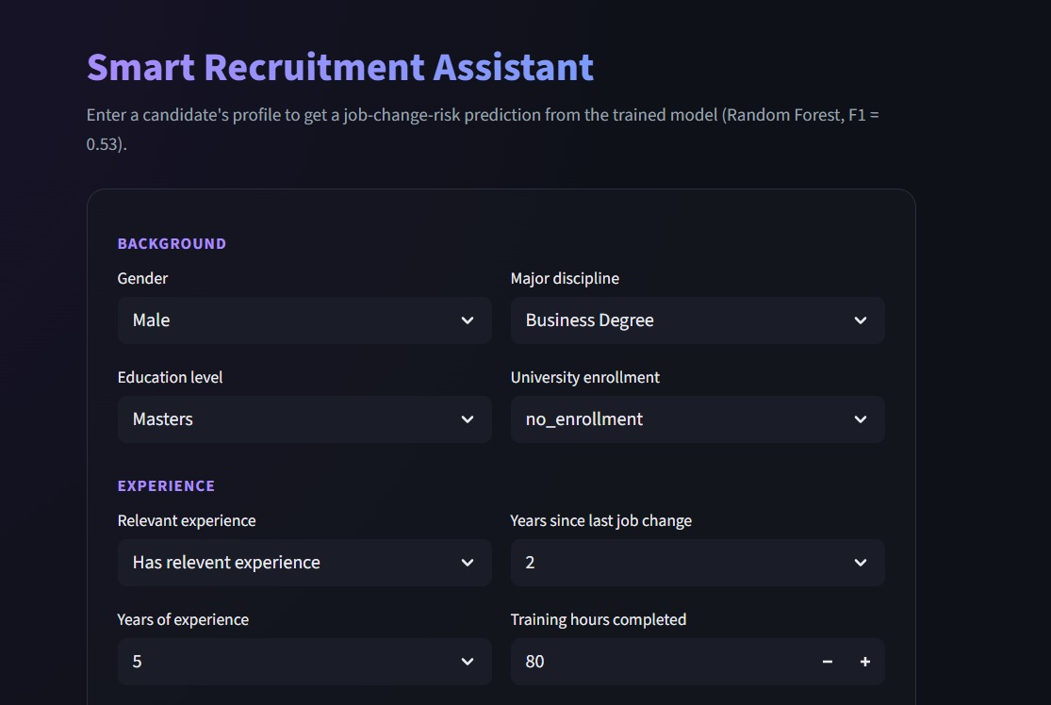
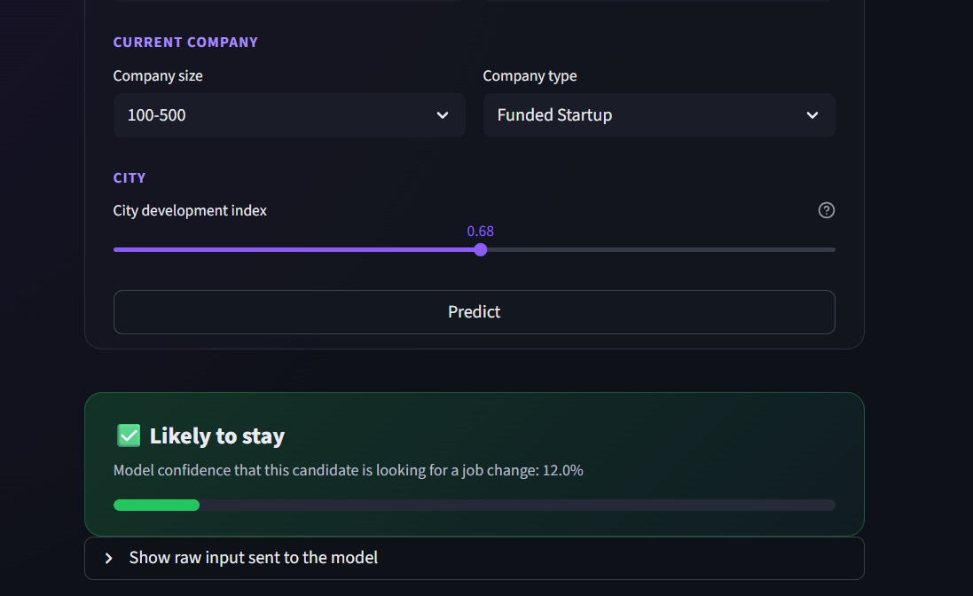
9. Final Prediction System — Demo
FINAL TAKEAWAY
A complete workflow was developed from data preparation to model comparison and selection.
Random Forest delivered the strongest F1 Score and was selected as the best-performing model.
10 / 12

Slide 11
10.Conclusion
The project demonstrates how Machine Learning can support HR recruitment by predicting candidate job-change intention.
Key Insights:
City Development Index was one of the most influential predictors.
Training hours were associated with higher job-change tendency.
Mid-level candidates showed higher job-change probabilities.
Future Work:
Improve Recall through better model tuning
Deploy the application to a hosted production environment
Add real-time candidate engagement data
11/12

Slide 12
Thank you
12/12

